Slide 1
Write the notes don’t draw the Pictures S2 INTRODUCTION TO COMPUTERS
KEYBOARD NAVIGATION

Slide 2
KEY BOARD NAVIGATION
MOUSE
A mouse is computer hardware input pointing device that is rolled about on a desktop to direct a pointer on a computer’s display screen.
It also complements the keyboard as regards input of data

Slide 3
USES OF A MOUSE
It is used to select and move around items displayed on the screen.
It is used to start tasks by positioning the pointer and selecting items.
It is used to create simple graphics.

Slide 4
TYPES OF MICE
Mechanical mouse
A mechanical mouse has a rubber or metal ball on its underside.
When the ball is rolled, it moves either the vertical (y-axis wheel) or horizontal roller (x-axis wheel) hence leading to the motion of the pointer on the screen.

Slide 5
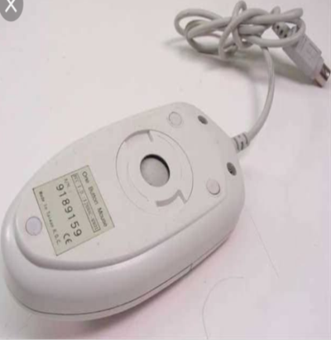
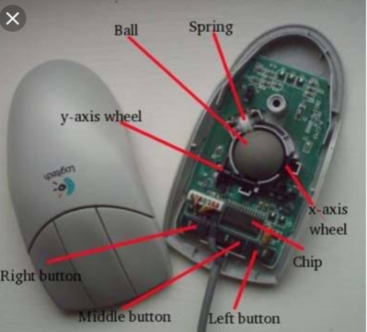
Mechanical mouse illustration

Slide 6
Optical mouse
Is a computer mouse which uses a light emitting diode and a light detector to detect movement relative to the surface.
An optical mouse is more precise/accurate than a mechanical mouse and does not require cleaning as does a mechanical mouse, but is more expensive.

Slide 7
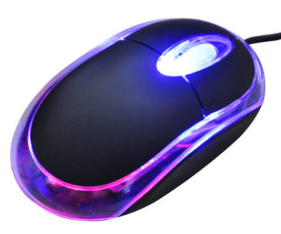
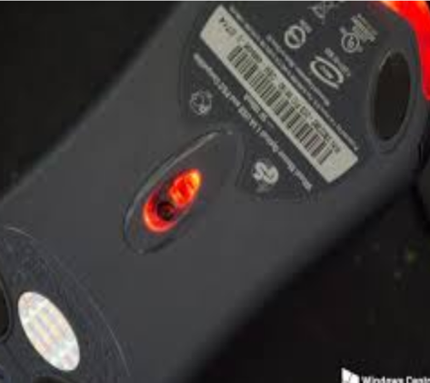
Optical mouse -illustration

Slide 8
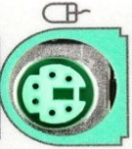
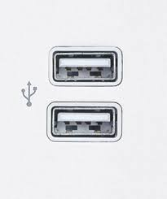
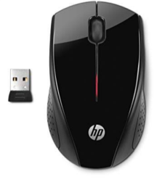
CONNECTING A MOUSE TO A COMPUTER
Many types connect with a cable to the system unit through a;
(a)Serial port (c) PS/2 port,
(b) USB port
Other mice are connected by use wireless technology and they are called wireless
mouse/ cordless mouse.
A wireless mouse (or cordless mouse) is a battery-powered device that transmits data using wireless technology, such as radio waves or infrared light waves.
Wireless mouse with its receiver

Slide 9
TERMS USED WHILE USING A MOUSE
Point .It is to move a pointer to a desired spot on the screen such as over a particular object or word.
Click .It is to press and quick release the left mouse button. A click often selects an item on screen
Double click .It is to press and release the left mouse button twice as quickly as possible. Double click often opens a document or it starts a program.

Slide 10
Drag .It is to press and hold down the left mouse button while moving the pointer to another location on the screen.
Drop .It is to release the mouse button after dragging. Dragging and dropping makes it easy to move an item on the screen.
Right click .It is to press the right mouse bottom and release which brings up popup menu with options to chose from.
Scrolling .Involves rolling the wheel forward or backward that scrolls up or down a few lines.

Slide 11
ADVANTAGES OF USING A MOUSE
A mouse is user friendly for computer beginners.
A mouse is easy and convenient to use with a graphical user interface.
Using a mouse to select items or move to a particular position on the screen is faster than using a keyboard.
A mouse can be operated by one hand.

Slide 12
DISADVANTAGES OF USING A MOUSE
It is not easy and convenient to input text with a mouse.
Issuing commands with a mouse is slower than by using a keyboard especially to beginners.
It needs some practice in order to control a mouse properly.
A mouse is not accurate enough for drawings that require high precision.
A mouse usually requires a flat surface to operate.
A mouse needs more desk space to operate when compared with a trackball or a touchpad.

Slide 13
PROBLEMS THAT AFFECT THE PROPER FUNCTIONING OF A MOUSE
Dirt disrupts motion of ball.
Nature of the roll surface.
Disconnection of the chord in case the mouse falls on humps.

Slide 14
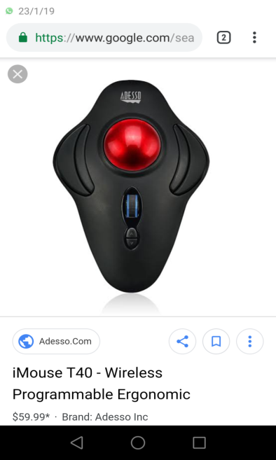
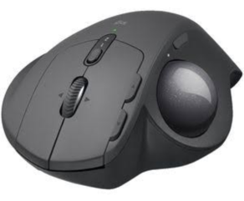
TRACKBALL MOUSE
Is a pointing device consisting of a ball hell by a socket containing sensors to detect a rotation of the ball about two axes like an upside-down mouse with an exposed protruding ball.

Slide 15
HOW TRACKBALL WORKS
The user rolls the ball to position the on-screen pointer using their thumb, fingers or commonly the palm of the hand while using the fingertips to press the mouse button

Slide 16
TOUCH PAD
A touch pad is a flat rectangular device that has weak electric fields to sense the touch as the users moves the finger tips.
It used to control the pointer with a finger. The Cursor follows the movement of the finger on the pad. You can click by tapping the pad surface.

Slide 17
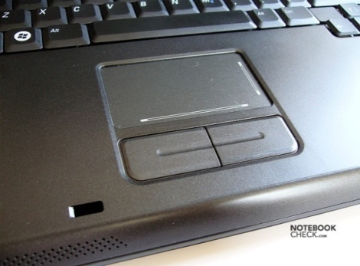

TOUCH PAD ILLUSTRATION

Slide 18
POINTING STICK
A pointing stick is a pressure-sensitive pointing device shaped like a pencil eraser.
Because of its small size, the pointing stick is conveniently positioned between the keys on the keyboard.
To move the pointer using a pointing stick, you push the pointing stick with your finger.
The pointer on the screen moves in the direction that you push the pointing stick.

Slide 19
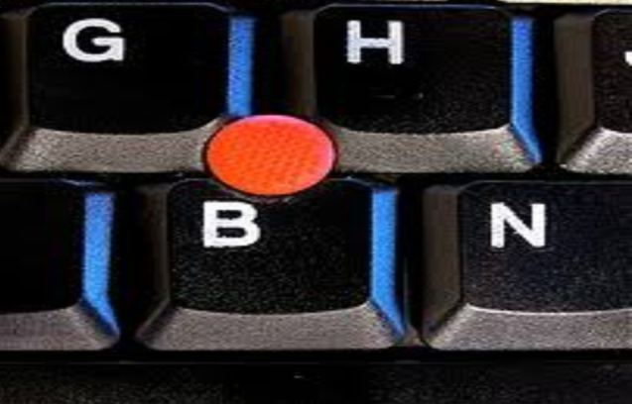
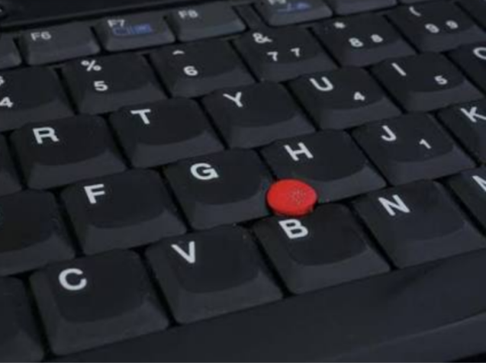
POINTING STICK ILLUSTRATION

Slide 20
LIGHT PEN
Alight pen is a computer input device in the form of a light-sensitive wand used in conjunction with a computer’s CRT display/monitor
It allows the user to point to displayed objects or draw on the screen in a similar way to a touch screen but with greater positional accuracy

Slide 21
TOUCH SCREEN
A touch screen is an electronic visual display that can detect the presence and location of a touch within the display area. Touch screens can also sense other passive objects, such as a pen.
Users can interact with these devices by touching areas of the screen. You touch words, pictures, numbers, letter, pointers or special locations identified on the screen.

Slide 22
USES OF A TOUCH SCREEN
Touch screens are often used for information kiosks located in department.
Touch screens are also used for ATM machines to allow easy access of bank accounts.
Touch screens are also used in some places like stores, hotels, air ports, museums allow access.

Slide 23
ADVANTAGES OF TOUCH SCREEN
No extra peripherals are needed except the monitor.
Touch screen allows easy access to commands, which are usually identified by words, symbols or images/icons on the screen.
No computer literacy is required.
They are easy to use and can convey information quickly.

Slide 24
KEYBOARD
Refers to a Computer hardware input text hard ware device that is used to type and enter instructions into a computer.
It looks like the keyboard of an ordinary typewriter but with some special keys like:
The control key (CTRL),
The Alter key (ALT),
The Escape key (ESC),
The Arrow keys, and
The function keys ranging from F1 to F12 and each key has its function.

Slide 25
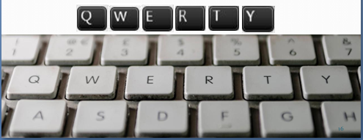
KEYBOARD LAYOUTS
The arrangement of the English language keyboard keys was modeled after the QWERTY type writer keyboard. Its name was derived from the first six letters at the top of the keyboard

Slide 26
TYPES OF KEYBOARDS
82 key keyboard
102 keyboard
102/3 enhanced keyboard (the most commonly used type today)
105 keyboard (developed from 102/3 enhanced keyboard)

Slide 27
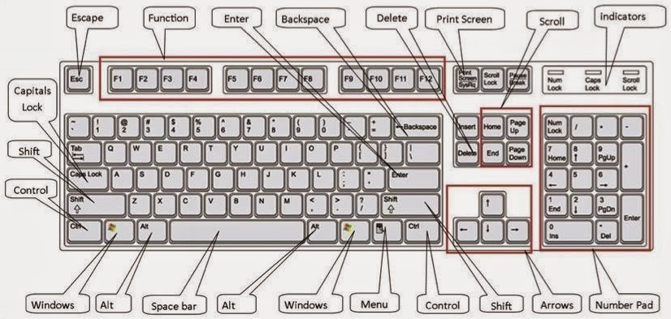
PARTS OF A KEYBOARD

Slide 28
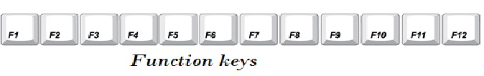
Functional keys
These are keys found across the top row of the keyboard. Each key is composed of letter F and a number ranging from 1 to 12. Each functional key performs a specific operation based upon the software being used.

Slide 29
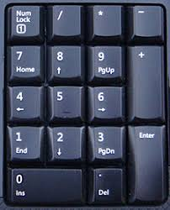
Numeric keypad
This is an extra section to the right of the keyboard. This is laid out like keys on a calculator.
It has two purposes, when the num keys is off, The numeric keys may be used as arrow keys for cursor movements and for other purposes such as; Page up (pg up), page down (pg dn), Home, and End

Slide 30
Typing area(Alphanumeric Keypad)
This consists of the letters of alphabets, numbers, punctuations marks and other basic keys like;
Shift key Tab key - Control key
Caps Lock - Alt key
Num Lock - Backspace key
Enter key - Delete key
etc.
Most of the typing is done with keypad.

Slide 31
FUNCTIONS OF SOME SELECTED KEYS ON THE KEYBOARD
Backspace Key. Deletes the characters to the left of the cursor (or insertion point) and moves the cursor to that position. Or Ctrl+ Backspace key removes the whole word to the left of the cursor.
Caps Lock Key. A toggle key that, when activated, causes all alphabetic characters to be uppercase. To facilitate continuous typing in upper case when activated.

Slide 32
Delete Key To deletes a character, space, on the right of the cursor position. Ctrl+Del removes the whole word to the right of the cursor position.
Space bar
To create space .
Pausing music in some music programmes e.g. Power DVD,
Playing games e.g. in pinball

Slide 33
Shift Key.
Activates second function of different keys.
Activates sticky keys
Modifies function Keys e.g. .Shift + F1 = F13 and Shift + F2=F14.
Esc Key
Short for Escape, this key is used to send special codes to devices and to exit (or escape) from programs and tasks.
Arrow Keys
Enable you to move the cursor (or insertion point) up, down, right, or left.
Used in conjunction with the Shift key to highlight text.

Slide 34
USES OF A KEYBOARD
A keyboard is used for a wide range of tasks such as;
Entering data from original paper documents e.g. entering raw marks in a computer.
Typing letters, memos, reports and other documents using word processing software.
Used to issue commands e.g. CTRL + S.

Slide 35
ADVANTAGES & DISADVANTAGES OF A KEYBOARD
ADVANTAGES
DISADVANTAGES
Most computers come with a keyboard supplied
People are used to using keyboards to enter data, they need very little training
A skilled typist can enter data very quickly
Specialist keyboards are available e.g. ergonomic, gaming keyboards
It is easy to make mistakes when typing in data
If you can't touch type, it can be time consuming to enter data
Keyboards are not suitable for creating diagrams
Disabled people often find keyboards difficult to use
Excessive use can lead to health problems such as repetitive strain injury (R.S.I.)

Slide 36
VOICE RECOGNITION EQUIPMENT/VRE
Voice recognition is the ability of the computer to react to someone speaking.
Voice recognition software will take in the voice signal being picked up by a microphone and sound card, and then process it in order to extract commands. For instance, you can use your voice to;
Start programs.
Open menus and other objects on the screen.
Dictate text document.

Slide 37
What you can do with keyboard and mouse can be done with only your voice.
NOTE: Voice recognition programs don’t actually understand speech but they only recognize vocabulary of reprogrammed words.

Slide 38
ADVANTAGES AND DISADVANTAGES OF VOICE RECOGNITION SYSTEMS
MERITS
DEMERITS
No typing of data is necessary.
The system can be used by people whose hands are occupied or disabled.
Voice recognition systems are also ideal for blind or visually impaired users.
Dictating text is faster than typing.
Error rate is still high at the moment.
Recognition of words is slow.
Words sound the same e.g. see and sea can‟t be distinguished.
The system is not suitable for use in noisy places.
The software must be trained to recognize specialists of technical words.
Many people find it difficult to speak in writing style.

Slide 39
SOME SHORTCUT KEYS AND THEIR FUNCTIONS
F1: Universal Help in almost every Windows program.
Ctrl + A: Select all text.
Ctrl + X: Cut
Shift + Del: Cut selected item.
Ctrl + C: Copy selected item.
Ctrl + Ins: Copy selected item.
Ctrl + V: Paste selected item.
Shift + Ins: Paste.
Home: Goes to beginning of current line.
Ctrl + Home: Goes to beginning of document.

Slide 40
End: Goes to end of current line.
Ctrl + End: Goes to end of document.
Ctrl + Left arrow: Moves one word to the left at a time.
Ctrl + Right arrow: Moves one word to the right at a time.
Ctrl + B: Bold highlighted selection
Ctrl + P: Open the print window.
Ctrl + F: Open find box.
Ctrl + I: Italic highlighted selection.
Ctrl + U: Underline highlighted selection.
Ctrl + V: Paste.

Slide 41
Ctrl + Y: Redo the last action performed.
Ctrl + Z: Undo last action.
Ctrl + Del: Deletes word to right of cursor.
Ctrl + Backspace: Deletes word to left of cursor.
Ctrl + D → Delete the selected item and move it to the Recycle Bin.
Ctrl + Esc → Open the Start Menu.
Ctrl + Shift → Switch the keyboard layout.
Ctrl + Shift + Esc → Open Task Manager.
Ctrl + F4 → Close the active window.

Slide 42
There are so many other short cut keys endeavor always to learn more and more
End

